Slide 1
Wikipedia Vandalism Detection
A Machine Learning method for protecting Wikipedia pages.
William Diedrick

Slide 2
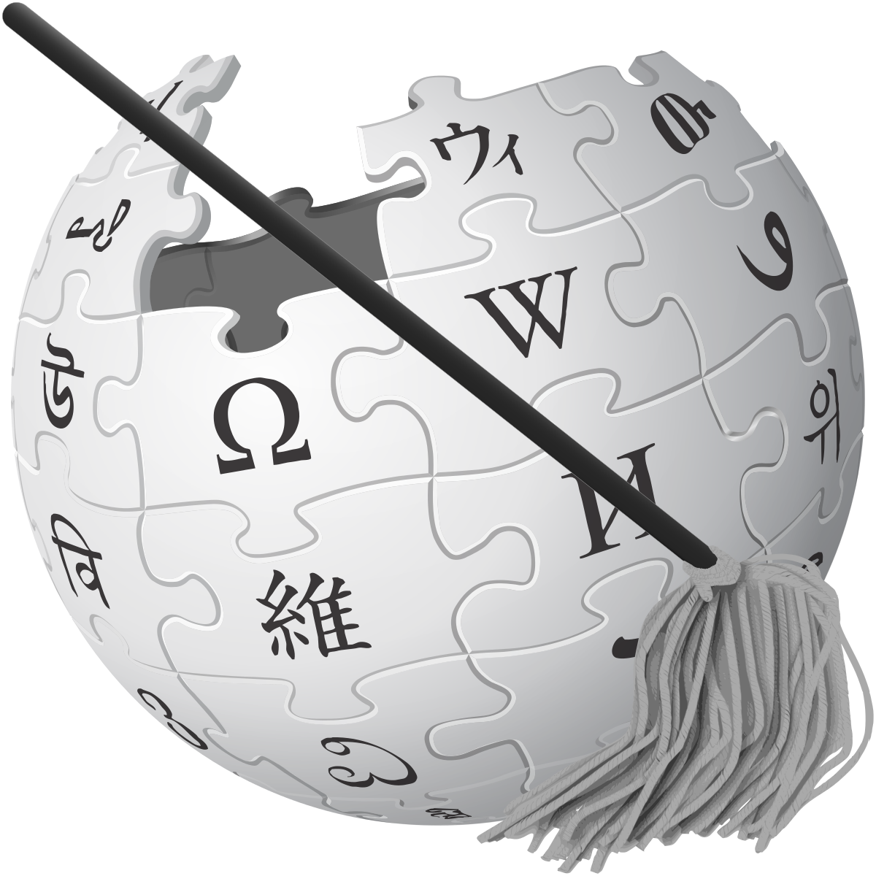
Agenda
Introduction
Fundamentals
Model
Example
Methodology
Live Demo
Improvements
Conclusion
References

Slide 3
Introduction
Wikipedia is an open source project that relies on the collaboration of many users to build Wiki-pages.
Anyone can access the meta-data of a Wiki-page and edit the contents of it.
How can we make sure that the information being placed onto the page is constructive and not vandalism?
We can turn to the use of Machine Learning to solve this issue. Specifically, we will be using the Machine Learning method of Bayesian Inference.
Bayesian inference is a method in which Bayes' theorem is used to update the probability for a hypothesis as more evidence or information becomes available.

Slide 4
Fundamentals
This Bayesian system can analyze proposed insertions to a specific Wikipedia page
This project will test the Darrell Krueger Library Wikipedia page.
Based on the words in the insertion, the system will identify what is considered constructive and vandalism based on a list of words already determined to be constructive and vandalism.
It will then add the insertion to whatever list it determines it to be, adjusting or setting the weights of all words proposed.
A Bayesian value will be calculated from the weights of constructive and vandalistic words in an insertion and shown to the user.

Slide 5
Model
Wikipedia API
When determined to be vandalistic/constructive, places words in list
Words already on a page
Driver
Threshold
Bayesian
Inference Engine
Splits Words
Check Words in lists
Calculate Bayesian Value [0 . . 1]
Constructive Words
Insertion, Threshold
Insertion
Word Check
Vandalistic Words
.TXT Files
Bayesian Val
Bayesian Val
Weight of Word

Slide 6
Example
Constructive:
“The Darrell Krueger Library is a constructive environment that contains many resources”
“Computers are available for students to use”
Vandalism:
“Pizza is a breakfast item that can be enjoyed on early afternoons”
“i like pie”

Slide 7
Methodology
The Bayesian Inference Engine determines whether an insertion is constructive or vandalistic by analyzing each word.
It compares it to each word in the stored text files, counting how many times it appears.
It makes a probability that a word is constructive for the whole insertion.
The probabilities are averaged to construct a Bayesian Value.
Words are added to a whitelist or blacklist depending on the Bayesian Value.

Slide 8
Improvements
Use of Neural Net with Bayesian Inference engine
  Spelling value
  Size of Insertion
  Bayesian Value
No implementation for punctuation/spelling errors
Implementation of words and weights with a hashmap
Implementation of a filter that can clear the .txt files randomly

Slide 9
Conclusion
The Bayesian Inference Engine functions well for the trials (minimal error)
It’s performance is improved with more testing, words, and better machinery
ClueBot NG makes use of Bayesian Inference and Neural Nets
  It’s performance is dramatically increased
  Further development of this project should include a Neural Net
This machine learning system can be used to protect Wikipedia databases from vandalism. ClueBot NG is a working system that proves the utility of a project like this.

Slide 10
References
Adler, Thomas. “Combining natural language, metadata, and reputation features.” Wikipedia vandalism detection, Springer-Verlag, dl.acm.org/citation.cfm?id=1964776.
Breneman, C., Carter, J., Tim1357. “ClueBot NG.” Wikipedia, Wikimedia Foundation, 28 Nov. 2017, en.wikipedia.org/wiki/Wikipedia:Bots/Requests_for_approval/ClueBot_NG.
Gotze, Paul. “Advanced Vandalism Detection on Wikipedia.” 3 Sept. 2014. http://www.uni-weimar.de/medien/webis/teaching/theses/goetze_2014.pdf
“Krueger Library.” Wikipedia, Wikimedia Foundation, 23 July 2017, en.wikipedia.org/wiki/Krueger_Library.

